Slide 1
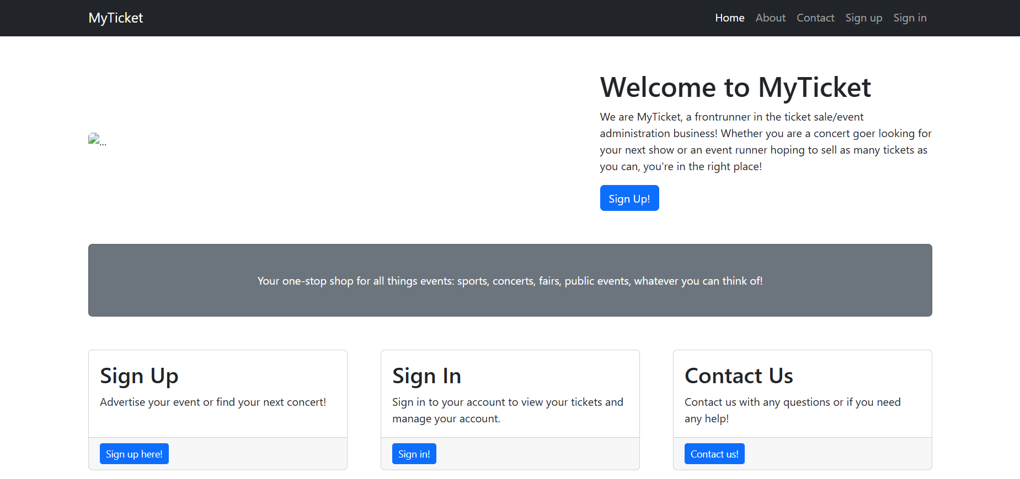
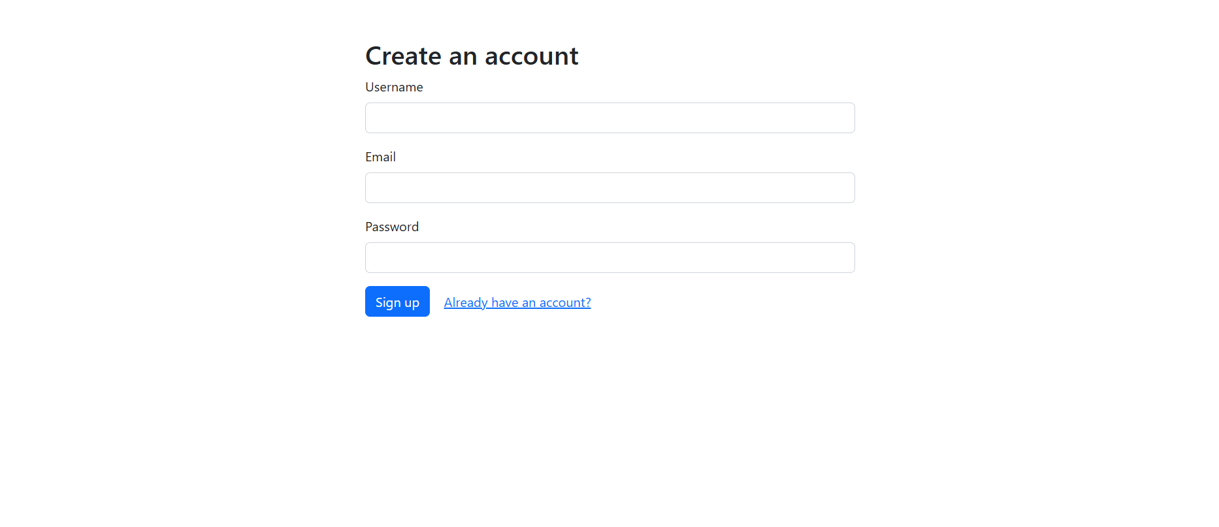
MyTicket
An event ticketing platform to rival sites like Ticketmaster.

Slide 2
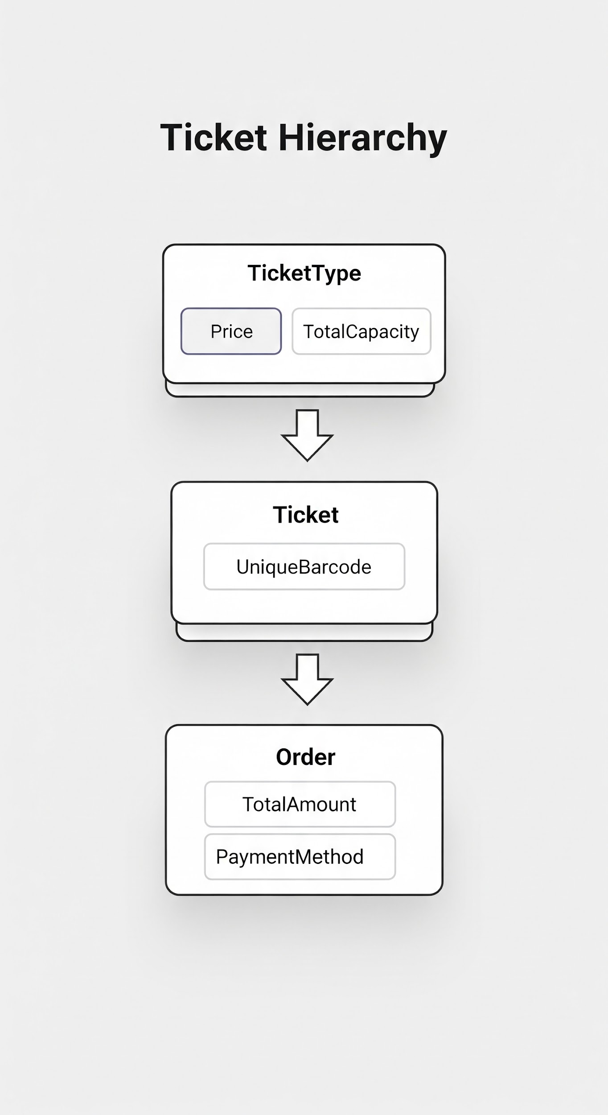
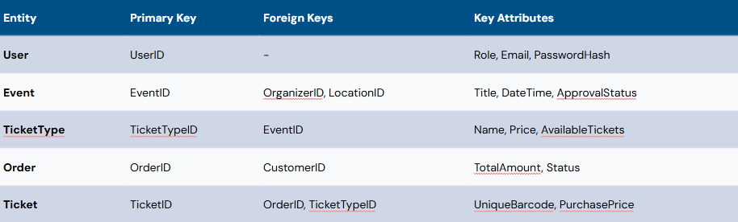
ERD

Slide 3
Team Contributions
Tyler: Static pages, presentation,
Sri: Create event, Edit Event, Delete Event, Organizer Dashboard, View Sales, Database for the events.
Justin: Login, Logout, create user, admin, admin edit, database.

